Slide 1
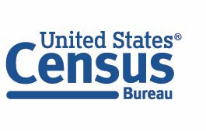
2020 Census Count Question Resolution Operation (CQR)
Presented By: Matthew Frates, Branch Chief, Count Question Resolution Branch
Decennial Census Management Division (DCMD)
September 21, 2022
Connect with us
@ uscensusbureau

Slide 2
CQR Overview
The goal is to improve the quality of the base used for post-2020 Census population estimates.
Count corrections are issued, when necessary, to the tribal chairperson or highest elected official of affected governmental units and be uploaded to the CQR website as errata.
CQR corrections will be reflected in the Census Bureau’s population estimates program.
CQR will not revise the apportionment data sent to the office of the President, any redistricting data sent to the states, or the Demographic and Housing Characteristics file.
CQR may not collect any new data and is not the same as a Special Census.
CQR it is not a mechanism to address data concerns due to disclosure avoidance methods applied by the Census Bureau.
Connect with us
@ uscensusbureau

Slide 3
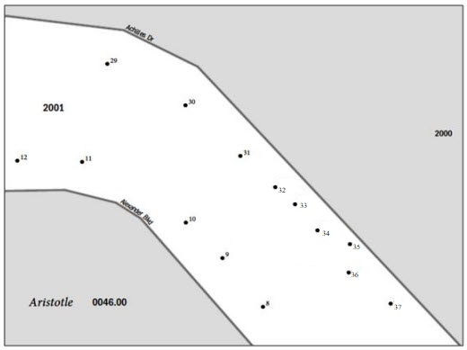
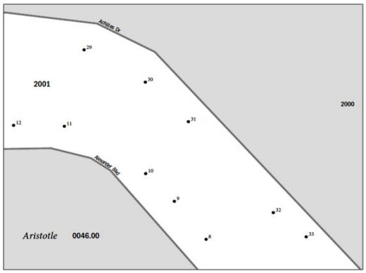
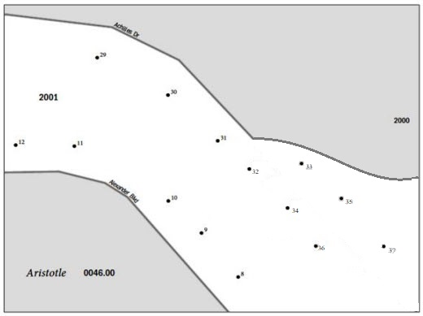
CQR Case Outcomes
Before and After – Examples of Corrections (examples show fictitious information)
Living Quarter Count case, Geocoding correction example:
Living Quarter Count case, Coverage correction example:
Boundary case correction example:
Connect with us
@ uscensusbureau

Slide 4
CQR Workflow
Tribal, state, and local governments review published 2020 Census results. If they suspect errors with their boundaries or their housing counts by block, they may file a CQR case.
CQR staff receives cases, reviews the case materials for correctness and completeness, and determines whether the case is in or out of scope.
In-scope cases are sent to Census geographic subject matter experts for research and resolution. During research, staff will review the 2020 Census enumeration and processing records in conjunction with the evidence supplied with the CQR case. Research may or may not find processing errors in the 2020 Census data.
If no processing errors are found, there will be no updates and the case is closed. If processing errors are found, they are addressed within Census Bureau records and systems. Once resolved, the Census Bureau will provide certified counts to any governments impacted by the CQR case.
The Census Bureau provides the disposition for each CQR case to the appropriate the highest elected official(s) of all impacted tribal, state, and local government(s), and posts the errata on the 2020 CQR website in the event of a change.
Connect with us
@ uscensusbureau

Slide 5
CQR Key Dates
December 2021: The Census Bureau sent a message to the tribal chairpersons and highest elected officials at tribal, state, and local governments who are eligible to file a CQR case.
January 2022: Census Bureau began processing CQR cases from eligible tribal, state, and local governments, researching the census enumeration records from each GU.
June 30, 2023: The Census Bureau stops accepting CQR cases.
September 30, 2023: Deadline for the Census Bureau to provide results to impacted GUs.
Connect with us
@ uscensusbureau

Slide 6
Current Status
Case Status | Total
Cases Received | 49
Cases Under Scope Review | 10
Closed Due to Incomplete Documentation | 6
Withdrawn Cases | 3
In-Scope Cases | 30
Connect with us
@ uscensusbureau

Slide 7
Questions?
For more information please visit:
2020 Census Count Question Resolution Operation (CQR): CQR website with high-level information about the operation.
CQR Case Status List
What To Consider If You See An Unexpected Census Result
Email: dcmd.2020.cqr.submissions@census.gov
Phone: (888)-369-3617
Thank you!
Connect with us
@ uscensusbureau

